Slide 1
eChat Trunking Solution
A Trunking Solution over Operator Network

Slide 2
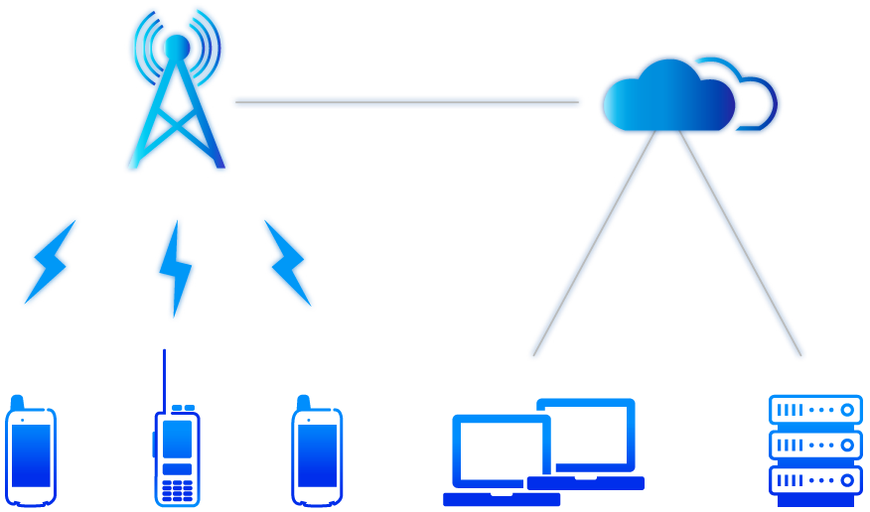

Operator Network Trunking Solution – eChat
Operator Network
Intenet
eChat solution takes the wide-area trunking service as the core requirement.
Provides multi-scenario convergence services for the industrial customers.
Create the best Internet + digital trunking service platform.
Dispatch Console
Management Console
eChat Radio
eChat Servers

Slide 3
Overview of eChat Solution

Slide 4









eChat System Architecture
Management Console
Dispatching
Console
Servers
Data Base
Service Platform
PLMN
External System
Switch
PSTN
Gateway
Internet
2G/3G/4G/Wi-Fi Network
Operator Network
Terminal
Handheld Radio
Vehicle Mounted Radio

Slide 5
eChat System Architecture
All of the network elements support load sharing and disaster redundancy!
PDS
PHR
LDS
MMS
Switch
Dispatch Console
LMS
OTA
VDS
DRS
eChat servers
Management Console
Firewall
Internet
Mandatory
Optional

Slide 6
eChat Server Description
PDS
Control center of the PTT voice service
PHR
Management of users and groups authentication
LDS
Management of the users and groups location
MMS
Management of messages, images and multimedia files
LMS
For the user login and registeration
OTA
For the user remotely update APK
VDS
Control center of the video service
DRS
Storage of voice and video recording data
Notes:
PDS-PTT Dispatching server
PHR-PTT Home Register
LDS-Location Dispatching server
MMS-Multimedia message server
LMS-Local maintenance server
OTA-Over the air
VDS-Video Dispatching server
DRS-Data recording server

Slide 7
eChat Solution – Key Technologies
Trunking Features
  Push-To-Talk:: Press the PTT button and then talk
  One-to-many call: Large call capacity and instant communication with many members
Key Technologies
  Multi-mode Access Network
    Our eChat service is independent of the bearer network, so that it can be performed in different access networks, such as 2G, 3G, 4G and Wi-Fi.
  Modularization and Distributed Design
    Our eChat system adopt modularization and distributed technology to design, it can be deployed according to different capacity scenarios.
    The distributed technology may ensure the system redundancy, stability and service continuity.
    The modularization design to make the future expansion easy and fast.
    Our eChat system support PC server or cloud based deployment.

Slide 8
eChat Solution Features
  Voice
  Group call
  Half-Duplex Private Voice Call
  Full-Duplex Private Voice Call
  Floor Priority
  Late Entry
  Information Synchronization and Update
  Emergency Alarm (under developing)
  Call Status Indication
  User Status Indication
  Data
  Multimedia Message
  Location Information Delivery
  Video
  Video Backhaul
  Video Push
  Video Forwarding and Distribution
  Concurrency of Voice and Video Service
  Multiple Video Sources Supporting
  Dispatch Console
  Dispatching
  Temporary group call
  Status Subscription
  Local Voice Recording
  Triple Screens
  Management Console
  Agent Management
  User Account Management
  Fleet and Group Management
  Organization Management
  System Maintenance
  Management Data Import and Export
  Positioning
  Real-Time Location
  Historical Track
  Circle Selection Call
  Ranging
  Geo-fencing
  Location Data Export
  Unified Storage
  Unified Voice Storage
  Unified Video Storage
  Reliability
  OTA
  System Data Disaster Recovery
  Interconnection
  Interconnection with DMR
  Interconnection with TETRA
  Interconnection with LTE B-TrunC
  Industry Customization Service
  911 Alarm Tri-party Call
  Merchant One-Click Alarm
  Logo Customization
  Roll Call in Dispatch Console
  High Priority Group
  Map Industry Layer Display
  Secondary Development Interface
Notes:
White: Basic Features/Yellow: Advanced Features/Orange: Customized Features

Slide 9
eChat Solution Roadmap
V5.80.10
V5.80.20
V5.80.30
V5.80.40
  Terminal Service
  Support temporary group call on terminal with large screen
  APK adaptation for e700
  Support IP camera
  Voice Service
  High priority group call
  SMS/MMS Service
  Send picture with location information
  Quality of Service
  Power consumption reduction and speech quality improvement
  Management console concurrent capability improvement
  Interconnection
  Interconnect with GoTa system
  Operation Management Service
  Account with terminal and SIM card binding
  One-Click alarm service access control management
  Management console support interconnection account
  Management console support hierarchical management
  Dispatch Service
  Dispatch console support multi voice dispatch mode
  Dispatch console support local video recording
  Dispatch console ease of use improvement
  System Deployment
  Support PC server based Mini eChat deployment
  Voice Service
  Inter-group call priority
  Dispatch Service
  Dynamic regrouping
  Emergency alarm
  Support map-based third party industry layer
  Circle selection call support SMS/MMS
  Support industry user use different icon to display
  Terminal Service
  Voice local recording
  Video local recording and storage
  Data Service
  SMS/MMS support read receipt
  Broadcasting message
  Video Service
  Video dispatch service support accompanying sound
  Site enforcement recorder access
  Operation Management Service
  Terminal model white list control
  System capacity license control
  Voice Service
  Voice encryption
  Dispatch Service
  Remote stun/revive
  All subscribers locating
  Operation Management Service
  Video service license control
  Storage service license control
  Online/offline user data export
  Voice service statistics export
  Video service statistics export
  Message service statistics export
  Video Service
  Terminal transfer video and foward a copy to dispatch console
  System Deployment and Reliability
  Support board-based Mini eChat deployment
  Support main and standby Mini eChat deployment
2018.06.30
2018.12.30
2019.06.30
2019.12.30
  Released
  Developing
  Planned
Planning

Slide 10



Group Call
A radio or dispatcher initiate a half-duplex voice group call.
All group members must press the PTT button to talk.
If a user request for the floor when someone is talking, the user must queue up to wait or take over the floor who is talking.
Floor Request

Slide 11

Private Call
Private call means a one-to-one call during which other users cannot hear the conversation.
A private call can be initiated by a radio or a dispatcher.
The system support half-duplex voice private call and full-duplex voice private call.
Dispatcher

Slide 12
Priority Service, Working First
Floor Priority
  The member with high priority talk first, which ensures that important work first.
  The members with the same priority queue up to talk, which ensures well-organized communication.
High Priority Group
  Users belong to both general group and high priority group.
  If a high priority group initiate a call when a general group is calling, users who belongs to these two groups will be disconnected from the general group forcibly and then join the high priority group.
  Emergency Alarm
  Users who has the privileges may initiate an emergency alarm in case of emergency. When initiating emergency alarm, the default dispatcher will received the alarm, and the user's location will be shown on the map, the video will be pulled up to the default dispatch console.

Slide 13
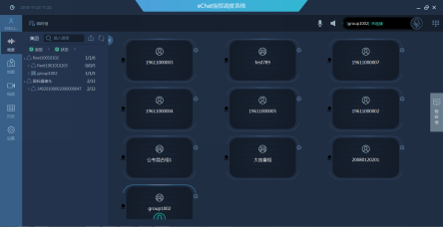
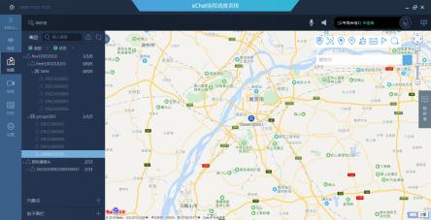
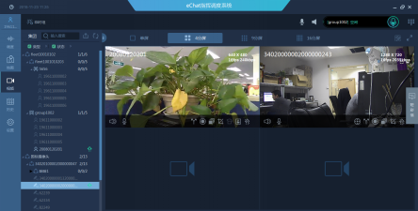
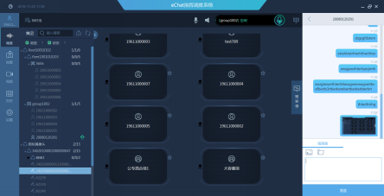
Dispatching Console
Voice Dispatch
Location Service
Video Dispatch
MSG Service
  Voice dispatch, private call, group call, record and replay.....
  Location service, user location, group location, track and replay.....
Video dispatch, video pull, video distribution, screen record, snapshot, screen capture.....
MSG service, SMS/MMS, text message, picture, video, file transmitting.....
History, storage service, video record, audio record, local record, electronic fence, multimedia message.....

Slide 14
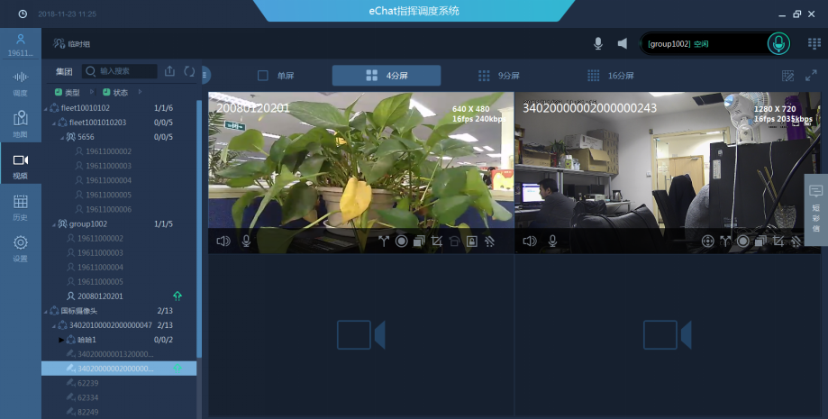
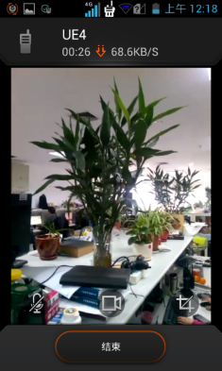
Video Backhaul
Backhaul
Pull-up by dispatcher
  Video backhaul means a one-way video session initiated by the radio or dispatcher.
  Dispatcher video pull-up means pulling the video of the specified radio or camera to the dispatch console.
  Radio video pull-down refers to the radio may pull video from other radios or cameras.

Slide 15
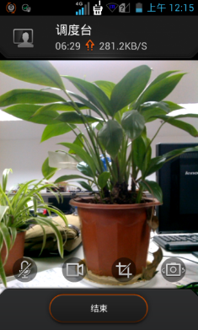
Video Push
Push
Real-time video push from the radio
  The video push service is initiated by radio.
  A radio can push its local real-time video to other radios, dispatch console and groups.

Slide 16
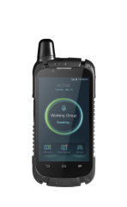
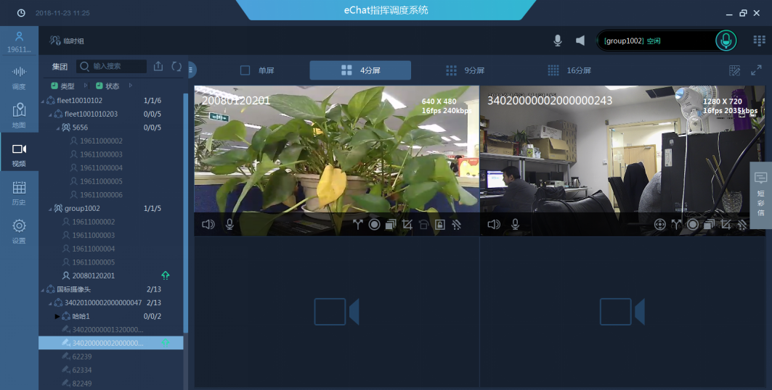

Video Forwarding and Distribution
Distribution
Push
Distribution
Real-time video push from the radio
Distribution
  A dispatcher can forward the received video to other dispatch consoles or handheld radios, or send the video to the TV wall, achieving cooperative video dispatch of multiple dispatch consoles and video users.

Slide 17




eChat Interconnection with DMR
Management Console
Dispatching
Console
Servers
Data Base
eChat Platform
The uGW is a gateway which may interconnect eChat with DMR.
Unified management and unified dispatching.
uGW
DMR Core Network
2G/3G/4G/Wi-Fi
DMR BS
Handheld Radio
Vehicle Mounted Radio
Handheld
Radio
Vehicle Mounted Radio

Slide 18

eChat Trunking System – Highlights
Operator network, interconnection with operator's core network, access network, bear network, providing QoS-based trunking services.
Low TCO, NO need dedicated frequency band, NO need dedicated network, providing QoS-based trunking services over operator network.
Interconnection with traditional dedicated trunking systems, such as DMR, TETRA and B-TrunC.
End-to-end solution, provide service platform, radios, dispatch console, management console.
PC server or cloud based deployment of service platform, distributed load sharing and redundancy protection, easy for expansion and upgrade.
MCPTT evolution, our eChat system support Mission Critical Push-To-Talk evolution.
Distributed eChat system support unlimitation capacity expansion.

Slide 19
Products

Slide 20
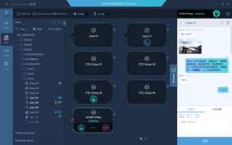
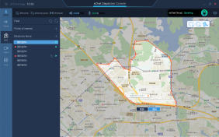
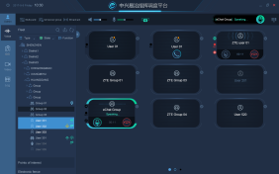
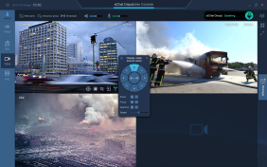
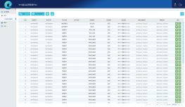

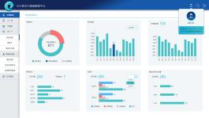
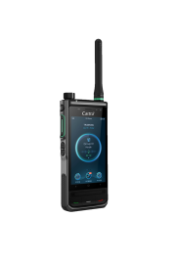




PoC
Dispatch
Management
Voice Dispatch
Video Dispatch
MSG Service
Location Service
eChat Management Platform
Transmission
VPN / Internet
Terminals
e350
e700
GH65X
GH880B
GH820
GH910
(Developing)
(Developing)

Slide 21
eChat Platform Portfolio
Voice/Location/Message
Voice/Location/Message/Video/Storage
Voice/Location/Message/Video/Storage
mini-eChat5000_1
mini-eChat5000_2
Distributed eChat
1x Server
1x fixed IP address
Up to 5K users
2x Server
2x fixed IP address
Up to 5K users
Up to 50 video streamings
5x Server
2x fixed IP address
Up to 10K users, extension capable with more servers
Up to 100 video streaming(720P),or 200 VGA streamings
mini-eChat2000
1x Server
1x fixed IP address
Up to 2K users
Up to 8 video streamings

Slide 22
Mini-eChat Product Introduction
Minimized eChat Platform
Aimed at Small-sized/Medium-sized Channel or Enterprise Customers
Support Basic and Advanced Features
Support PC Server or Cloud Based Deployment
Support 2000 or 5000 System Capacity
Support Interconnection with Other Systems

Slide 23
Mini-eChat Product Configuarion
Mini-eChat_2000
 |  | Mini eChat 2000 (Basic and Advanded Features)
 |  | Configuration | Description | Remark
Voice service processing unit (PDS) |  | √ | Stand alone | 1. All of the service units will be deployed in one server. 2. All of the service units does NOT support expansion, tailoring and customization.
Database unit (PHR) |  | √
Login management service unit (LMS) |  | √
Online upgrade service unit (OTA) |  | √
Location service processing unit (LDS) |  | √
Multimedia message service processing unit (MMS) |  | √
Video service processing unit (VDS) |  | √
Data Storage unit (DRS) |  | √
Interconnection GateWay (uGW) |  | Optional | Stand alone | Optional for interconnect with the other private trunking system.
Agents | Dispatching Console | Optional | ≧1 | Agent used for management and dispatching.
 | Management Console | Optional
Switch |  | √ | ≧1 | Mandatory, used for connect all servers.
Firewall |  | √ | ≧1 | Mandatory, used for protect all servers.
Scenarios
Configuration Options

Slide 24
Mini-eChat Product Configuarion
Mini-eChat_5000_1
 |  | Mini eChat 5000_1 (Voice/Location/SMS/MMS Only)
 |  | Configuration | Description | Remark
Voice service processing unit (PDS) |  | √ | Stand alone | 1. This scenario will deploy PDS, PHR, LMS, OTA, LDS and MMS service units only, all of above service units will be deployed in one server. 2. All of above deployed service units does NOT support expansion, tailoring and customization.
Database unit (PHR) |  | √
Login management service unit (LMS) |  | √
Online upgrade service unit (OTA) |  | √
Location service processing unit (LDS) |  | √
Multimedia message service processing unit (MMS) |  | √
Video service processing unit (VDS)
Data Storage unit (DRS)
Interconnection GateWay (uGW) |  | Optional | Stand alone | Optional for interconnect with the other private trunking system.
Agents | Dispatching Console | Optional | ≧1 | Agent used for management and dispatching.
 | Management Console | Optional
Switch |  | √ | ≧1 | Mandatory, used for connect all servers.
Firewall |  | √ | ≧1 | Mandatory, used for protect all servers.
Scenarios
Configuration Options

Slide 25
Mini-eChat Product Configuarion
Mini-eChat_5000_2
 |  | Mini eChat 5000_2 (Basic and Advanded Features)
 |  | Configuration | Description | Remark
Voice service processing unit (PDS) |  | √ | Stand alone | 1. This scenario will deploy all of the service units, the PDS, PHR, LMS, OTA, LDS and MMS will deployed in one server. 2. The VDS and DRS service units will be deployed in another server. 3. All of the service units does NOT support expansion, tailoring and customization.
Database unit (PHR) |  | √
Login management service unit (LMS) |  | √
Online upgrade service unit (OTA) |  | √
Location service processing unit (LDS) |  | √
Multimedia message service processing unit (MMS) |  | √
Video service processing unit (VDS) |  | √ | Stand alone
Data Storage unit (DRS) |  | √
Interconnection GateWay (uGW) |  | Optional | Stand alone | Optional for interconnect with the other private trunking system.
Agents | Dispatching Console | Optional | ≧1 | Agent used for management and dispatching.
 | Management Console | Optional
Switch |  | √ | ≧1 | Mandatory, used for connect all servers.
Firewall |  | √ | ≧1 | Mandatory, used for protect all servers.
Scenarios
Configuration Options

Slide 26
Distributed eChat Product Introduction
Distributed eChat Platform
Aimed at Medium-sized/Large-sized Channel or Operator Customers
Support Basic and Advanced Features
Support Industry Customization Features
Support PC Server or Cloud Based Deployment
Support 10000+ Active User Capacity and Unlimitation Expansion
Support Interconnection with Other Systems

Slide 27
Distributed eChat Product Configuration
 |  | Distributed eChat System (All Features)
 |  | Configuration | Description | Remark
Voice service processing unit (PDS) |  | √ | Stand alone/ Load sharing | PDS support load sharing according to the voice service traffic.
Database unit (PHR) |  | √
Login management service unit (LMS) |  | √ | Stand alone | 1. LMS support distributed deployment according to the accessed subscribers. 2. LMS support N+1 backup.
Online upgrade service unit (OTA) |  | √
Location service processing unit (LDS) |  | Optional | Stand alone/ Load sharing | 1. LDS support load sharing according to the location service traffic. 2. Storage space for location service may expand by add hard disk.
Multimedia message service processing unit (MMS) |  | Optional |  | 1. Optional for short message service and multimedia message service. 2. MMS support load sharing according to the SMS/MMS service traffic.
Video service processing unit (VDS) |  | Optional | Stand alone/ Load sharing | 1. Optional for video service. 2. VDS support load sharing according to the video service traffic.
Data Storage unit (DRS) |  | Optional | Stand alone/ Load sharing | 1. Optional for voice storage and video storage. 2. DRS support load sharing according to the stroage service traffic.
Interconnection GateWay (uGW) |  | Optional | Stand alone | Optional for interconnect with the other private trunking system.
Agents | Dispatching Console | Optional | ≧1 | Agent used for management and dispatching.
 | Management Console | Optional
Switch |  | √ | ≧1 | Mandatory, used for connect all servers.
Firewall |  | √ | ≧1 | Mandatory, used for protect all servers.
Scenarios
Configuration Options

Slide 28
eChat Trunking System – Typical Specification
Item | Mini eChat 2000 | Mini eChat 5000 | Distributed eChat
Maximum online users | 2,000 | 5,000 | ≧10,000(Expandable)
Maximum online groups | 100 | 200 | ≧1,000(Expandable)
Maximum concurrent voice calls | 100 | 200 | ≧1,000(Expandable)
Maximum concurrent 720P video backhaul | 8 | 50 | ≧100(Expandable)
Concurrent location users (30 seconds interval) | 2000 | 5000 | ≧10,000(Expandable)
Number of concurrent voice recordings | 50 | 100 | ≧100(Expandable)
Number of concurrent video recordings | 5 | 10 | ≧50(Expandable)
Maximum record storage period | 90 days | 90 days | 90 days
Server Quantity(Dell PER740) | 1 | 2 | ≧5 ( Expandable)

Slide 29
eChat Trunking System – Typical Configuration
Configuration Option | Mini eChat 2000 | Mini eChat 5000 | Distributed eChat
Voice service processing unit (PDS) | DELL PER740 | DELL PER740 | DELL PER740
Database unit (PHR)
Login management service unit (LMS) |  |  | DELL PER740
Online upgrade service unit (OTA)
Location service processing unit (LDS) |  |  | DELL PER740
Multimedia message service processing unit (MMS)
Video service processing unit (VDS) |  | DELL PER740 | DELL PER740
Data Storage unit (DRS) |  |  | DELL PER740
Interconnection GateWay (uGW) | DELL PER640/740 | DELL PER640/740 | DELL PER640/740
Agent (Dispatch Console/Management Console) | PC | PC | PC
Terminal | e350/e700/GH651A/GH820/GH880B/GH910

Slide 30
mini-eChat Migration to Distributed eChat (1)
Voice/Location/Message
Voice/Location/Message/Video/Storage
Voice/Location/Message/Video/Storage
mini-eChat5000_1
mini-eChat5000_2
Distributed eChat
1x Server
1x fixed IP address
Up to 5K users
2x Server
2x fixed IP address
Up to 5K users
Up to 50 video streamings(720P)
5x Server
2x fixed IP address
Up to 10K users, extension capable with more servers
Up to 100 video streaming(720P),or 200 VGA streamings

Slide 31
mini-eChat Migration to Distributed eChat (2)
Voice/Location/Message/Video/Storage
Voice/Location/Message/Video/Storage
mini-eChat2000
Distributed eChat
1x Server
1x fixed IP address
Up to 2K users
Up to 8 video streamings(720P)
5x Server
2x fixed IP address
Up to 10K users, extension capable with more servers
Up to 100 video streaming(720P),or 200 VGA streamings

Slide 32

  Terminal - e350 handheld radio
eChat PTT
LTE-FDD: B1/B2/B3/B4/B5/B7/B8/B20/B28
LTE-TDD: B38/39/40/41
WCDMA: B1/B2/B5/B8
Small and portable, 88 * 54.5 * 29.8mm, 200g
Loud speaker, 1W Power Rating
Voice assistance optional
1.3 inch B&W LCD , 128x48 display
GPS/AGPS
4000mAh battery
IP54
e350

Slide 33
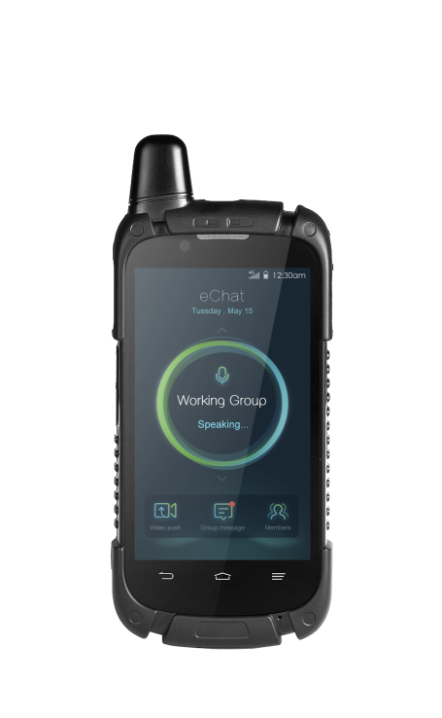
  Terminal - e700 handheld radio
eChat PTT
Network: WCDMA/LTE
LTE-FDD: B1/3/20/28
LTE-TDD: B38/39/40/41
WCDMA: B1/B8
4.0 inch, 800*480, LCD touchable display
Wi-Fi, BT
13M pixels rear camera
VoLTE
GPS/AGPS
4000 mAh battery
IP54

Slide 34

  Professional Terminal - GH651A handheld radio
eChat PTT
LTE-FDD: B3/B20/B31
Wi-Fi
DMO
Professional radio design
2.2 inch LCD and keypad
Android OS
Camera back & front
GPS/BDS
Multiple sensors integrated supporting various apps
IP67

Slide 35

  Smart Terminal – GH880B
eChat PTT
LTE-TDD: B38/B39/B40/B41
LTE-FDD: B1/B3/B5/B7/B8/B20/B31
WCDMA: B1
GSM: B2/B3/B5/B8
DMO
Screen: 4.8-inch high definition LCD
Front & Rear camera: 5 &13 megapixels, CMOS
Wi-Fi, BT, NFC
Battery: 4500 mAh
IP67
GH880 eChat

Slide 36

  Smart Terminal – GH820
eChat PTT
LTE-FDD: B1/B3/B5/B7/B8/B20/B28
LTE-TDD: B38/B39/B40/B41
WCDMA: B1/B2/B5/B8
GSM: B2/B3/B5/B8
Screen: 5.7-inch high definition LCD
Front & Rear camera: 13 megapixels, CMOS
Wi-Fi, BT, NFC
Battery: 3500 mAh
IP67
GH880 eChat

Slide 37

  Dual Model Terminal – GH910
eChat PTT
LTE and DMR dual mode
LTE FDD: B1/B3/B5/B7/B8
LTE TDD: B38/B39/B40/B41
WCDMA: B1/B8
GSM: B2/B3/B5/B8
DMR: UHF1
Screen: 4.0-inch high definition LCD
Front & Rear camera: 13 megapixels, CMOS
Wi-Fi, BT, NFC
Battery: 4000 mAh
IP67
GH880 eChat

Slide 38
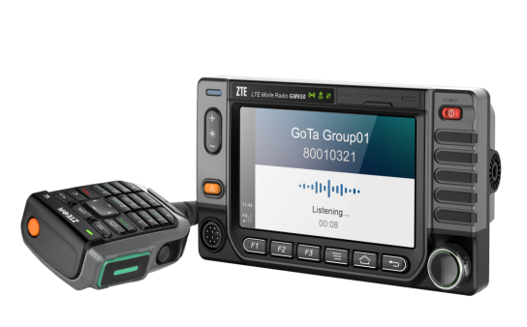
  Professional Terminal - GM651A Vehicle Mounted Radio
eChat PTT
FDD-LTE: B3/B20/B31
DMO
Wi-Fi
5.0 inch touchscreen and keypad
Android OS
Support external USB/IP camera
GPS/BDS
IP54
GM655 eChat

Slide 39
Cases

Slide 40





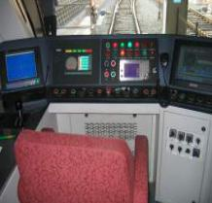






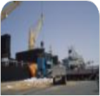

Application Scenarios
Trafic Police
Water Supply
Taxi
Oil Field
First Aid
Customs
Tranportation
Factory
Logistics
Hospitals
City Utilities
Airport
Construction
Sea Ports

Slide 41




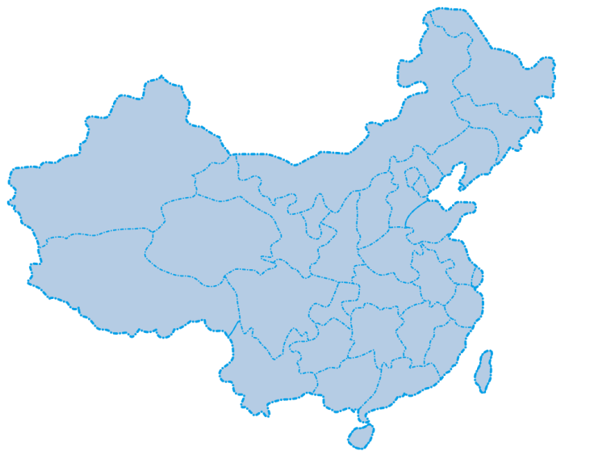




eChat Trunking System Global Footprint
China
Spain
Indonesia
Turkey
South Africa
Pakistan
Colombia
Kenya

Slide 42


