Slide 1
Caltta Tactical LTE Solution
A leading provider of comprehensive critical communication solutions
© 2019 Caltta Technologies Co., Ltd. All Rights Reserved
Privacy statement: Caltta Technologies Co., Ltd. is committed to protecting personal data by the use of appropriate technical and organisational measures.

Slide 2
Understanding of Tactical LTE
1
CONTENTS
2
Product and solution
3
Case study

Slide 3







Evolution of Professional Trunking Standards
Analog
Digital
Narrowband
Broadband
Public/Private Networks Convergence
Analog
GSM
CDMA
WCDMA
TD-SCDMA
CDMA2000
TD-LTE
FDD-LTE
Public network
LTE
5G
MPT
B-TrunC
MCPTT
Private network

Slide 4
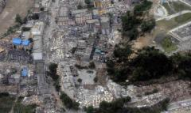
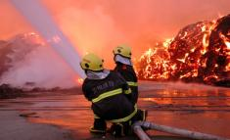
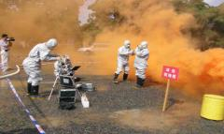
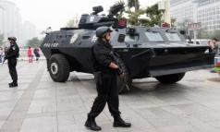
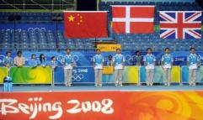

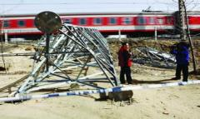
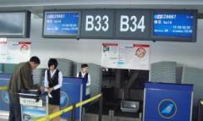
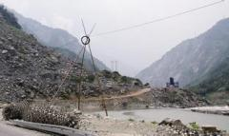
Various Crisis & Emergency Scenarios
Flood, earthquake, typhoon, land slide
Fire disaster, explosion emergency
Plague , casualties rescue
Natural disaster
Major safety accident
Major public health safety emergency
demonstration, protest, violence
National meeting, sports event, exhibition, military exercise
National holidays
Society safety emergency
Important event
Holidays
Public network malfunction
Private network breakdown
Temporal emergency communication assignment
Network breakdown
Enterprise network breakdown
Temporal assignment

Slide 5




Different demands in different scenarios
Emergency communication peek time
Public emergency
Social safety event
Natural disaster
Emergency handling
Critical communication
Emergency command
Feedback from frontline
Emergency handling
Critical communication
Emergency command
GPS tracking
Suppress opponent’s communication
Network safety
Emergency handling
Critical communication
Emergency command
Communication restablishment
Traffic absorb
Prevent congestion
Avoid congestion & breakdown
Temporally expand capacity
Lower network burden
Ensure dispatch service

Slide 6

Tactical LTE System Advantage
Energy saving
Low power consumption
Long battery life
Mobility
Miniaturization
Portable
Re-deployable
High mobility
Small in size
Light in weight
Easy to carry
Mission critical communication system
Ease of use
Fast deployment
Easy to operate
Easy to maintain
Friendly UI
Modular design
High compatibility
Few device modules
Short activation process
Easy to activate
High
reliability
Shock resistance
Adapt severe environment

Slide 7



Caltta Tactical Solution Capability
Inter-
connect
Accurate
Smooth
Fast
Frotline and Command center
Different technologies
Different platforms
Ease of congestion
Priority Guarantee
Visible and audible
Real-time update
Deployment
Mobility
Operation

Slide 8
Understanding of Tactical LTE
1
CONTENTS
2
Product and solution
3
Case study

Slide 9
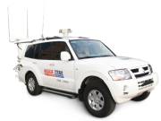

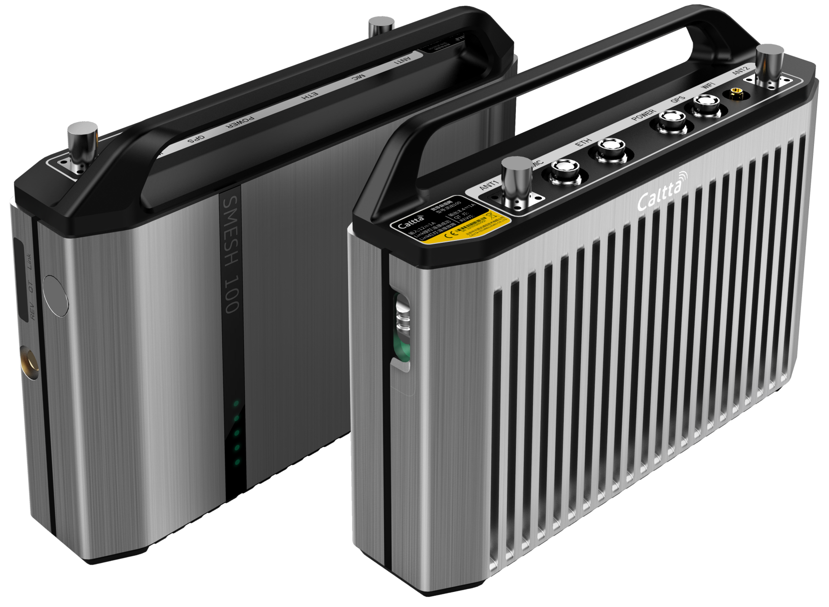

  Caltta Tactical LTE solutions
Emergency vehicle（ECV）
Portable emergency command system
Broadband Mesh Manpack System
Caltta Tactical System Specification

Slide 10
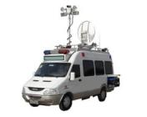
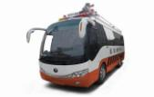
  Prudent design principle to ensure quality
Advanced system
System compatibility
New communication technology
Long life cycle
Unified standard
Compatible to each other
System maintenance
System expansion
simple, direct, easy to maintain
Average maintenance time：<30mins
provide multiple expansion
interface
Reserve expansion space
Design principle
System security
System addictiveness
Information security
Physical security
Electric security
Environment surveillance
Fully consider environmental difference in different regions
Ensure personnels’ survival and
interaction
Consider the reliability when
device is on the move
Redundancy design for key
units
Maximize the cost to performance ratio
Ensure sensible resource arrangement
System reliability
System cost

Slide 11
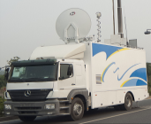
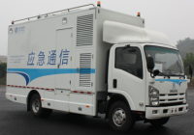
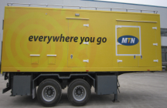
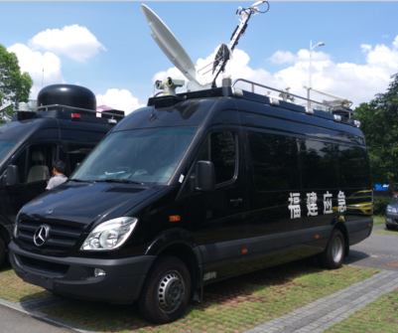
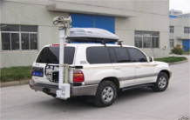
  Various customization option
Large Truck
Medium Truck
Semi-trailer
Minibus
SUV
Vehicle system
Compartment system
Microwave
Center control
Public Network
其
他
Mast system
Air-conditioner system
Video Surveillance
Trunking
Infrared warning
Balance system
Surveillance system
Power system
Grounding system
Shortwave
Satellite
Video Conference
Basic System
Extended system

Slide 12













  Detailed construct of the Basic Systems
Vehicle system
Compartment system
Mast system
Power system
Support various models and modifications
Support bulletproof, explosion-proof modifications
Support self-developed and original compartments
Meet device installation and extended requirements
Include lifting mast, mast attachment and control system
Can be fitted with feeder, microwave, lightning and aviation lights, etc
Power mode: Mains + generator + backup battery
DC & AC power distribution
Balance system
Air-conditioner
system
Surveillance system
Lightning Protection system
Includes monitoring box, auxiliary sensors and ancillary
Monitoring: Access control, smog, flooding, temperature, generator failures, etc
2 vehicle mounted air-conditioners on top, cooling and heating
1+1 backup and working in turn
B+C level lighting protection device
C level distribution box
line lightning protection , grounding copper
Automatic Balancing system
A combination of automatic and manual leveling

Slide 13
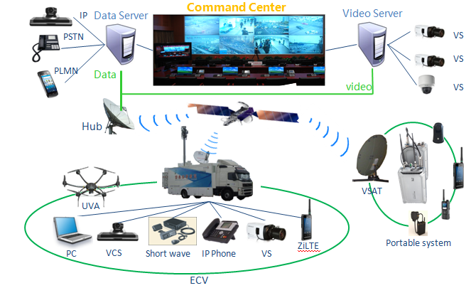













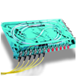

  Detailed construct of the Extended Systems
Trunking system including BBU, RRU, compact core network and dispatch console
1.4GHz/1.8GHz/400MHz/500MHz/600MHz/700MHz
Portable radio
Fast deployment
RRU
BBU+CN+MDS
Stationary surveillance
General communication structure
Trunking communication
Public network communication
Transmission device
Satellite/microwave/fiber combination
Satellite: Ku/C, 1.2-1.8m antenna.
Microwave: 7-38MHz, 0.3-0.6m antenna
Emergency vehicle base
station product series
C/G/U/L combination
850/900/1800/1900/2100MHz
S111 – S12/12/12
1T2R / 2T4R
Distributed
BTS BS8700
Macro
BTS BS8800
Optical fiber
Micro BTS
BS8906
Microwave
Satellite

Slide 14





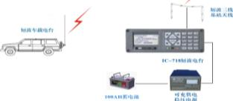

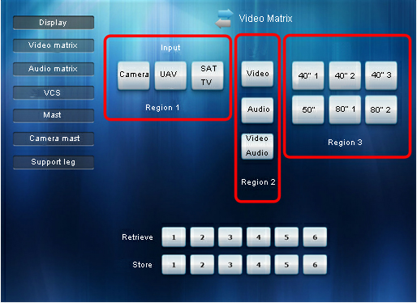

  Detailed construct of the Extended Systems
Wireless image transmission
Video surveillance
Video conference system
Man-pack system, vehicle mounted system and
command system
Entering hard-to-reach areas
Video transmission, storage and replay
Including camera, cloud station, recorder, HD TV,
decoder and control keyboard
Realize video conference among meeting sites and commanding site
Including camera, meeting terminal, microphone,
display, image processing device and control device
Short wave communication
Satellite IP telephone
Centralized control system
Control:
Camera
Display
Mast
Audio
Video
Short wave emergency communication system consists of mobile terminal and fixed station
High survivability, adaptive to harsh environments
Long-distance communication
IP telephone is directly connected to router, by using the satellite link it can directly communicate with other terminals and command center

Slide 15
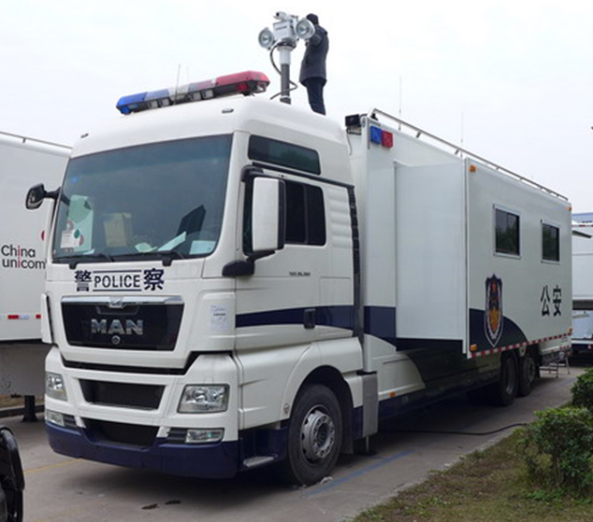
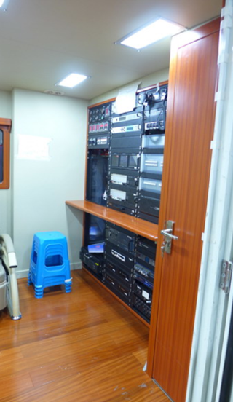
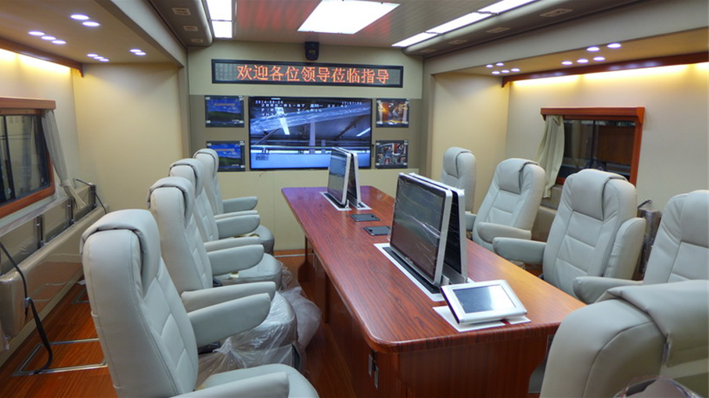
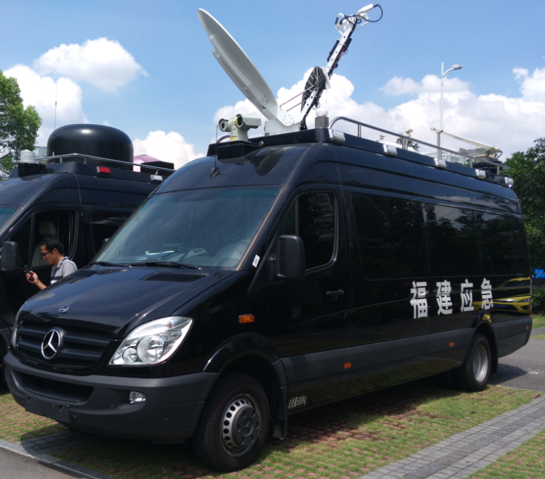
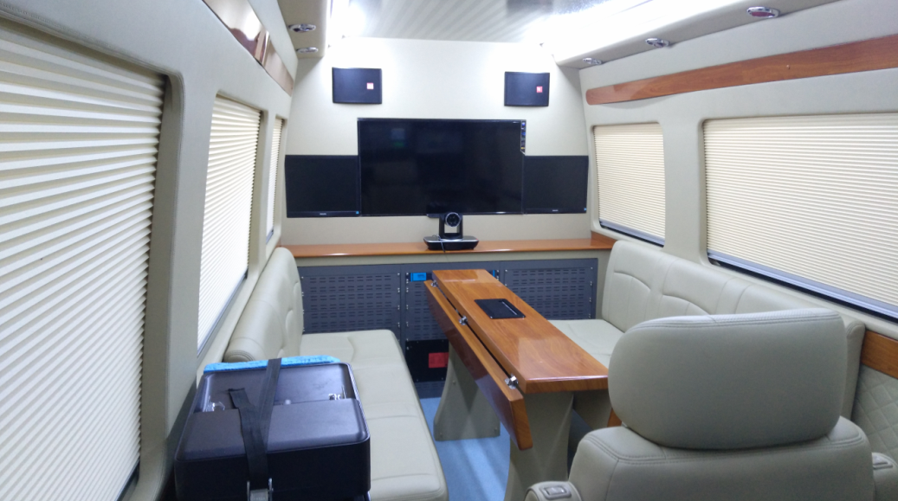
  Different scenarios, different application
Major event safeguard
large, medium size
carriage can expand on sides
large conference room is fitted inside
fully equipped commanding system
multiple location display
Fast deployment on site
medium, SUV vehicle
mobile and flexible
small conference room is fitted in Minibus vehicle
commanding and dispatching system combination
SUV suits harsh outdoor environment

Slide 16



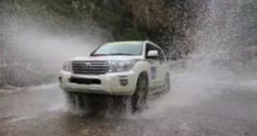
  Caltta ECV highlights
Fast deployment
Mast deployment： < 15min
System deployment time： <30min
High reliability
Safe, adaptive, firm, low failure rate
Perfect surveillance system
High mobility
Adaptive to all kinds of terrain and weather
Speed up to 180km/h
Professional mission critical communication
Visual dispatch
Advanced ZiLTE trunking system

Slide 17
  Caltta Tactical LTE solutions
Emergency vehicle（ECV）
Portable emergency command system
Broadband Mesh Manpack System
Caltta Tactical System Specification

Slide 18
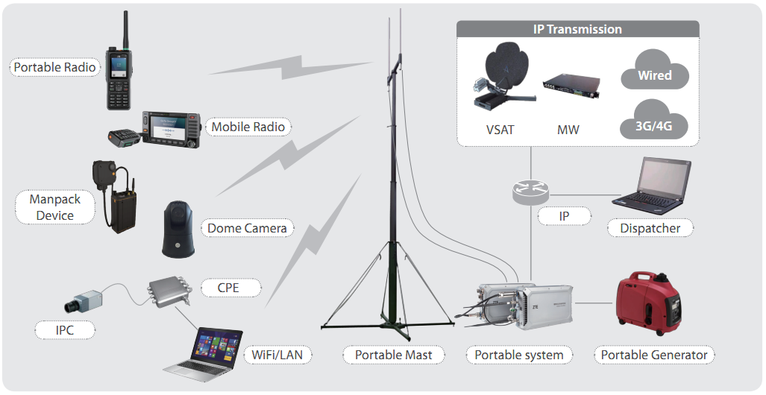
  Portable System：Powerful Performance and Perfect Solution
Light weight, High integration
Light weight design, one or two person backpack
High integration, includeing all NEs and servers
Fast deployment
Uniform power, start with one touch, ready within 10 minutes
High reliability
Based on mature and stable SDR platform
Rich Services
Audio & video professional PTT
HD video transmission and distribution
Video full duplex call
Data and multimedia services
Standard IP link interface
High adaptability
IP67 protection
-40℃～+60℃ working temperature
Reinforce and anti-vibration design

Slide 19
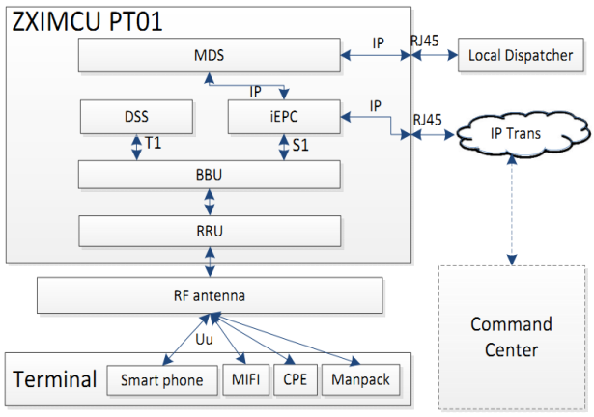
  Portable System：one integrates ALL
Trunking core network
Professional trunking services such as video, voice call
Multimedia dispatch server
Video dispatch, video distribution, SMS, MMS, image
MDS
iEPC
RRU
BBU
DSS
LTE core network
Network management, LTE user register, authentication and control
LTE base band unit
Baseband signal processing, user connection management, internal service management and data exchange
LTE remote radio unit
System radio signal processing, filtering, and amplifying, 2x2 MIMO

Slide 20
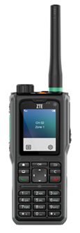



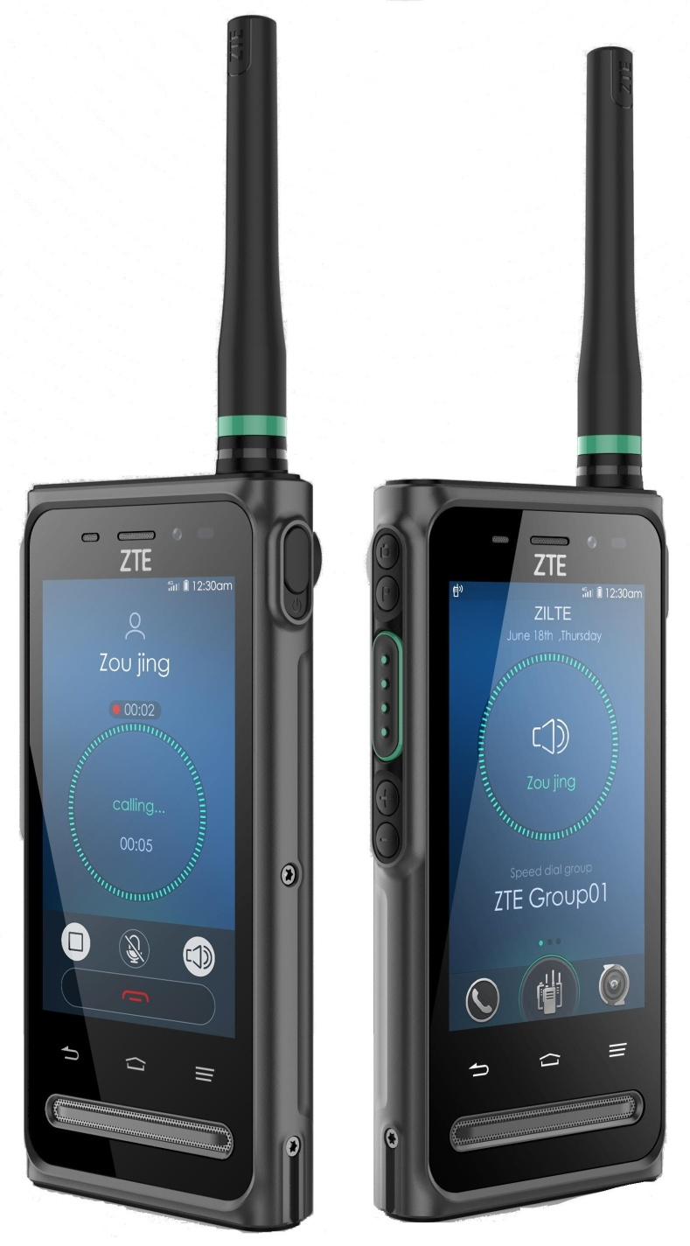
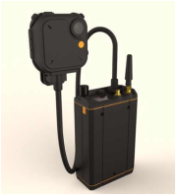
  Various terminals to meet the needs
Portable radio
Data terminal
GH650
Network GSM/WCDMA, TD-LTE 1.4G/1.8G
Screen：2.0inch
Battery：2000mAh
Protection level：IP67
Camera：1.3/8 mega pixel
Standard mini
PCIe module
Outdoor CPE
GH880
Network GSM/WCDMA, TD-LTE 1.4G/1.8G
Screen ：4.8inch
Battery：4500mAh
Protection level：IP67
Camera：5/13 mega pixel
Image transmission
1080p 30fps video
7hrs for a single charge
Weight 0.6kg

Slide 21

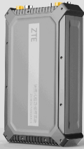
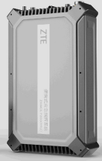

  Caltta Portable System advantages
  Separate design, light weight
  Aluminum alloy material, IP67
  Can be equipped with backpack or portable case
High mobility/high reliability
  Modular design
  One press to start
  Ready to work in 10 mins
Large Capacity
fast-accurate
Agile -mobile
  Core throughput：0.8G
  Max user：500
  Max group：100
  Radio pwer：2*40W
  Low power consumption：400W
Fast deployment
Rich trunking services
  Support private network trunking services
  Support HD video call, GPS, video services
  Support satellite, microwave, wired, public network backhaul

Slide 22
  Caltta Tactical LTE solutions
Emergency vehicle（ECV）
Portable emergency command system
Broadband Mesh Manpack System
Caltta Tactical System Specification

Slide 23
  Smart Mesh (sMesh) System
1. Mesh100：System Equipment
2. Management Console： PC and Software
3. Standard Accessories： Headset， GPS
4. Optional Accessories： Multimedia Module
Brige Module
Multimedia module
Bridge
module
GPS
sMesh 100
Headset

Slide 24
  sMesh System：There is always one for you
Disaster Recovery,
Highly secured
Center-less
co-frequency mesh
ALL-IP
Architecture
Various Topology,
Flexible Networking
VPN connection,
Various Networking
High Speed,
Broadband Data
Rich Services
Interference
Immunity
Multi-path
capacity
Abundant
interfaces

Slide 25
  Independent Networking of sMesh
This scenario uses sMesh system to rapidly establish Multi-node IP interconnection and link backhaul

Slide 26
  sMesh Backhaul
The sMesh system acts as the backhaul link between the spot and the command center.

Slide 27
  sMesh Extension
The portable LTE system provides ground coverage. For LTE coverage blind spots, the sMesh system acts as an extension to LTE network and realizes service backhaul

Slide 28
  Caltta Tactical LTE solutions
Emergency vehicle（ECV）
Portable emergency command system
Broadband Mesh Manpack System
Caltta Tactical System Specification

Slide 29
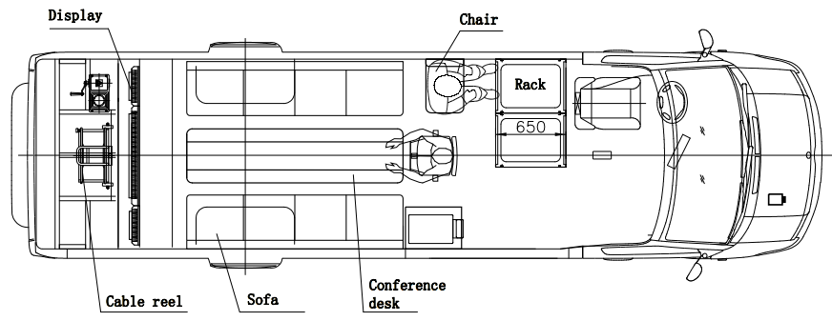
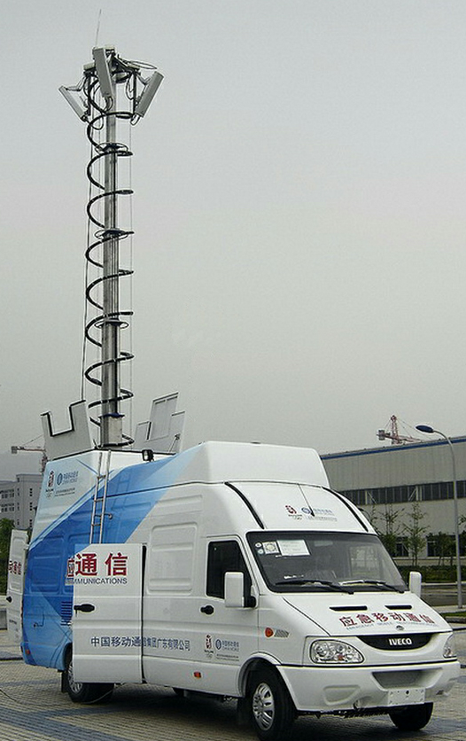
  Caltta ECV - Minibus Specification
Item | Solution
Vehicle | IVECO NJ5054
Radio System | 3 to 6 directional antennas
Transmission | IP, 1.2m VSAT, 0.3m MW for optional
Compartment | Reinforce and insulation refit
Power system | 9kva generator, UPS, rectifier, battery
Mast system | 10m electric mast and antenna bracket
Balance system | Electric support legs and controller
Temperature control | 2600W vehicle-mounted air-conditioner
Lightning protection & grounding system | Lightning rod & Grounding wire, Grounding bar
Parameter | Value | Parameter | Value
Model of chassis | Daily | Trademark of chassis | Minibus
External dimensions | Length x Width x Height：6999×2172×2841 mm
Number of axles | 2 | Axles distance |  | 3950 mm
Fuel type | Diesel | Drive type |  | 4 X 2
Engine type | FIC | Engine power |  | 95 kW
Emission Criteria | China National V | Displacement |  | 3 L
GVW | 5990 kg | Kerb Weight |  | 2800 kg
Payload | 3190 kg | Max speed |  | 125 km/h

Slide 30
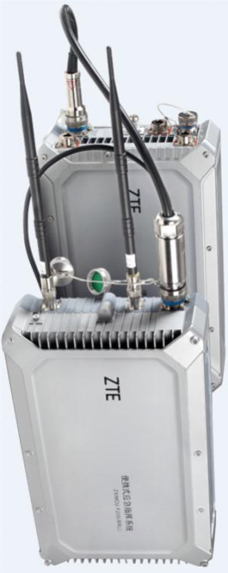
  ZTE Portable System Specification
Category |  | Specification
General | Main processing Unit(MPU) | Size：475mmx275mmx105mm Weight：10kg Power consumption：100W-150W
 | Remote radio unit (RRU) | Size：475mmx275mmx105mm Weight：12kg~20kg Power consumption：100-300W
Environment | Working temperature | -40℃-+60℃
 | Storage temperature | -50℃-+70℃
 | Atmospheric pressure | 70-106 kPa
 | Protection | IP67
 | Anti-vibration | GB/T 4798.7-2007 carry along and mobile use: above 7M2
 | Power | 100V-240V, 50HZ/60HZ AC 500W
Performance | Radio frequency | Band 28, Band 31, 1.4G TDD, 1.8G TDD, 500MHz
 | Network type | LTE
 | Support bandwidth | 5MHz、10MHz、15MHz、20MHz
 | RF power | 2x60W
 | RF signals | 2T2R
 | Ethernet port | GE/FE*2
 | Fiber port | 6G*2
 | Synchronization | GPS/1588V2/SYNCE

Slide 31
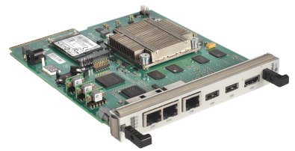
  Caltta ECV & Portable System Core Network Specification
Item | Specification
Call establish time | <300ms
Max user number | 500
Max group number | 100
Max access in eNodeB number | 10
Max online PTT call | 256
Throughput | 0.8 Gbps
Size(H×W×D) | 19 x 148.5x183 mm
Power consumption | ≤30W
RAM | 8G
Hard disk | SSD 250G
Ethernet port | 4, two in front and two in back
USB | 2
HDMI | 1
Serial port | 1
Other | Support outer 12V DC power

Slide 32
sMesh Parameters
Item |  | Parameter
Basic | Frequency | 450~650MHz，customizable
 | Mode | TDD
 | bandwith | 2.5M/5M/10MHz
 | Power | 2X2W, 2 channel 2T2R
 | Speed | Maximum 20Mbps
 | Network | None center，support 32 nodes
 | Hops | 9 hops
 | encryption | DES/AES128/AES256；
 | Battery | modular Li battery
Environment | temperature | -40℃～+60℃。
 | Protection | IP67
Physical | Size | 270mm × 170mm × 65mm
 | Weight | 4kg with battery 2kg withour battery
 | interface | RJ45, WiFi,Audio,,GPS(SMA), Power

Slide 33

  Versatile Services meet different requirements
Voice/video group call
Voice/video private call
Private full duplex call
Emergency call
Broadcast call
Late entry
Priority between groups
Priority between members
Remote stun, Remote revive
Time-limited call
…
Dynamic regrouping
GIS & map dispatch
Terminal History patch
Video surveillance
Video pull / push / distribution
SMS / MMS
Picture dispatch
Forced insertion / Release
Audio/Video recording
High-speed data service
End to end Encryption
…
Basic services
Advanced services

Slide 34
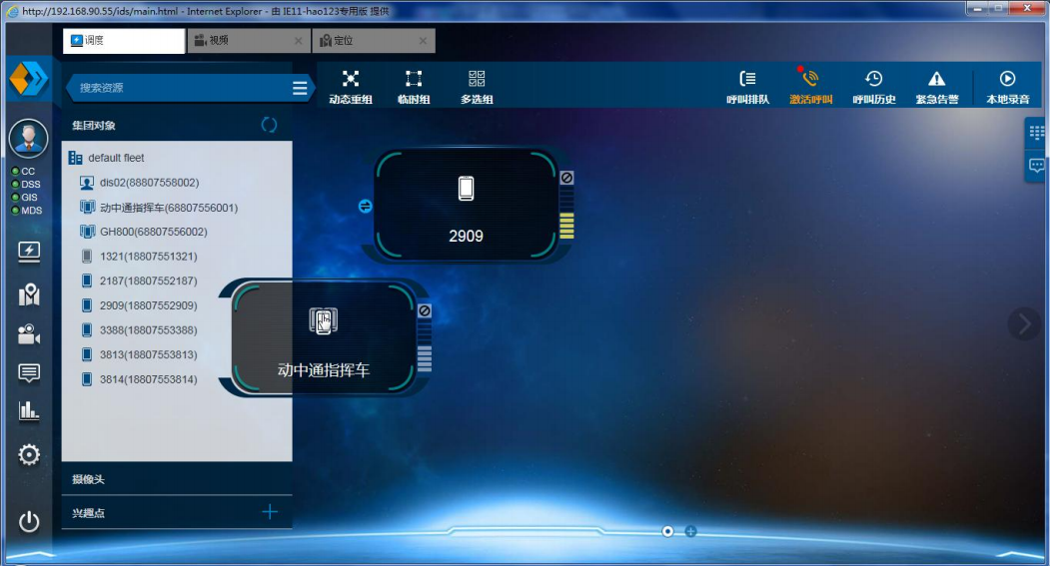
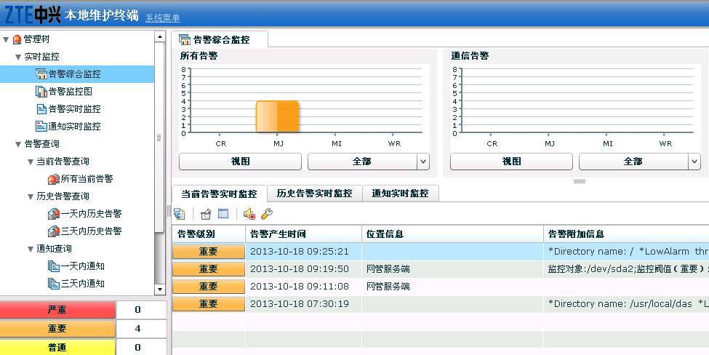
  Easy to operate and maintain
Dispatch management system
Local maintenaince system
Integrate Trunking dispatch and multimedia dispatch
Easy to use B/S architecture
Realize multimedia dispatch through video pull and distribution functions
Smooth upgrade, LMT provides critical data backup, and can be quickly rolled back when exception happens
Easy installation and data configuration, one press to start and use
Robust security mechanisms to prevent mis-operation

Slide 35
  Caltta Tactical LTE QoS Calssification
Caltta Tactical LTE system implements 9 QoS classification Identifiers (QCIs). The system allocates and schedules resources according to the QCI level. The smaller the priority, it will be prior to get resource allocation and scheduling.
QCI | Resource Type | Priority | Packet Data Delay | Packet Data Loss Probability | Service Example
1 | GBR (Guaranteed Bit Rate) | 2 | 100 ms | 10⁻² | Voice services, trunking voice
2 | GBR (Guaranteed Bit Rate) | 4 | 150 ms | 10⁻³ | Conversational Video, speed-guaranteed video surveillance
3 | GBR (Guaranteed Bit Rate) | 3 | 50 ms | 10⁻³ | Real Time Gaming, live online interactive services, PIS
4 | GBR (Guaranteed Bit Rate) | 5 | 300 ms | 10⁻⁶ | Buffered Streaming media services
5 | Non-GBR (Non-Guaranteed Bit Rate) | 1 | 100 ms | 10⁻⁶ | IMS Signaling
6 | Non-GBR (Non-Guaranteed Bit Rate) | 6 | 300 ms | 10⁻⁶ | Video services (buffered streaming), no fixed-rate video surveillance services, FTP, P2P, etc.
7 | Non-GBR (Non-Guaranteed Bit Rate) | 7 | 100 ms | 10⁻³ | Normal data services
8 | Non-GBR (Non-Guaranteed Bit Rate) | 8 | 300 ms | 10⁻⁶ | FTP, P2P, etc.
9 | Non-GBR (Non-Guaranteed Bit Rate) | 9 | 500 ms | TBD | Other services

Slide 36
  Caltta Tactical LTE Bit Rate Index
Caltta Tactical LTE system supports different uplink and downlink bit rate according to the bandwidth and technology selected.
 |  | 3MHz(FDD) |  | 5MHz(FDD) |  | 10MHz(FDD) |  | 20MHz(FDD) |  | 5MHz(TDD) |  | 10MHz(TDD) |  | 20MHz(TDD)
Max Number of Group Members |  | Unlimited |  | Unlimited |  | Unlimited |  | Unlimited |  | Unlimited |  | Unlimited |  | Unlimited
Max Number of Simultaneous Voice Group Calls |  | 60 |  | 160 |  | 320 |  | 320 |  | 60 |  | 160 |  | 320
Max Number of Simultaneous Video Group Calls |  | 8 |  | 22 |  | 54 |  | 126 |  | 8 |  | 22 |  | 48
Max Number of Simultaneous Video Upload | 512kbps | 6 |  | 17 |  | 41 |  | 94 |  | 6 |  | 17 |  | 36
 | 1Mbps | 3 |  | 8 |  | 20 |  | 47 |  | 3 |  | 8 |  | 18
Max Throughput of Single Cell (Mbps) | Time Slot Allocation | UL | DL | UL | DL | UL | DL | UL | DL | UL | DL | UL | DL | UL | DL
 | 0 (UL:DL 3：1) | 7.9 | 22.1 | 13.5 | 36.6 | 27.3 | 73.3 | 51 | 150.8 | 8.1 | 12.7 | 16.4 | 25.6 | 30.6 | 52.1
 | 1 (UL:DL 2：2) |  |  |  |  |  |  |  |  | 5.4 | 20.0 | 10.9 | 40.3 | 20.4 | 82.3
 | 2 (UL:DL 1：3) |  |  |  |  |  |  |  |  | 2.7 | 27.4 | 5.4 | 54.9 | 10.2 | 112

Slide 37
Understanding of Tactical LTE
1
CONTENTS
2
Product and solution
3
Case study

Slide 38
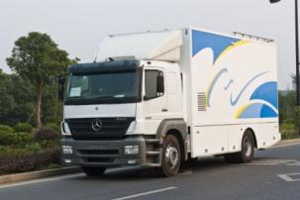
  Caltta ECV helps government and enterprise to develop
Item | Solution
Vehicle | Benz 1829, bulletproof CN：C level
Cabin | 6.5m length cabin, bulletproof CN：C level
Power system | Panda brand generator
Mast system | 13m height electric mast
Balance system | America bigfoot automatic hydraulic system
Temperature control system | Tiane military vehicle air conditioner
Monitor system | Temperature, smoke, flood, intrusion, etc.
Communication equipment | CDMA Gota system , 1.8m Dia. Vehicle satellite
Video Surveillance System | Standard definition infrared video monitoring system
Infrared early warning radar | Scanning range 500m
Short Wave Communication | Australia Polaroid military shortwave
Nigeria safety network
Customer demand
Enhance national security
Emergency handling capability
Unified command center
Customer benifit
Improve environment safety
Improve government image
Improve civillian life

Slide 39
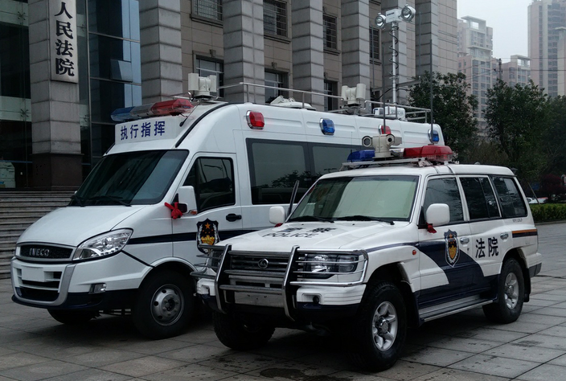
  Hunan Court ZiLTE vehicle commanding system
Project introduction
Hunan Changsha court command center has set up two sets of vehicle commanding system and dispatching system. It is used for law enforcement, video feedback, evidence capture and storage. The system is equipped with multimedia dispatch system (MDS), vehicle mounted LTE core network, base station, vehicle mounted radio antenna, and vehicle mounted camera and public 4G network feedback devices. Offices are equipped with touch screen portable terminal, built-in keyboard terminal and manpack terminal.
This project has already assisted Hunan court with many tasks. And it is highly praised by the customer.
service deployment
Frontline and backend co-operation with video dispatch service
Terminals on site record videos and send back to command center
Law enforcement team can bilaterally communicate with command center

Slide 40
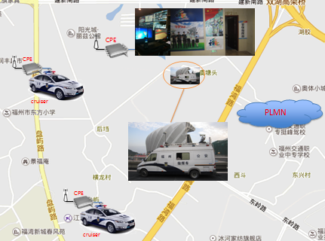
  Fuzhou police ZiLTE vehicle commanding center
Project introduction
Fuzhou police is equipped with a set of mobile ZiLTE command and dispatch system, including LTE core network, base station, radio, CPE, 15 sets of wireless HD cameras, etc.
The project has safeguarded the first national youth games as well as the Fuzhou straight Olympic Games. It provides video surveillance and patrol communication.
Services
The system is integrated into the Fuzhou emergency network in order to achieve real-time video feedback to emergency command center
CPE and PTZ camera are installed in the cruiser, realtime video can be transmitted wirelessly to achieve mobile monitoring.
System provides independent private network, offering rapid deployment of on-site monitoring, to achieve multi-directional screen monitoring and camera PTZ control.

Slide 41
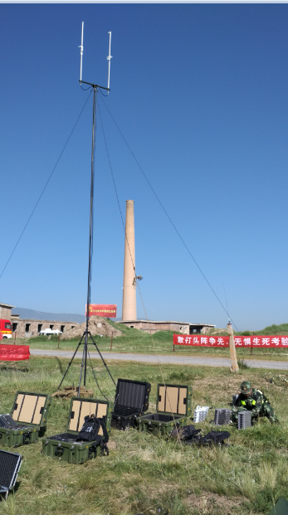
  Fire control / Earthquake Portable Center
Project introduction
Shenzhen fire control bureau has equipped with ZiLTE portable system. It is used for onsite fire situation detection.
System consists of multimedia dispatch system, LTE core network, base station and antenna. The whole set is integrated into a brief case for easy and fast deployment.
Service
Forward back video to command center via 4G public network
Indoor fire situation detection, dispatch, emergency aid and exit route searching
Onsite communication
Earthquake drill project introduction
Equipped with one set of portable ZiLTE command system for earthquake command and rescue on site
System includes multimedia system MDS, LTE corenetwork, basestation and antenna, video single prawn and handheld terminal
Service
Forward back video to command center via 4G public network
Handheld terminal communication
GIS positioning

Slide 42
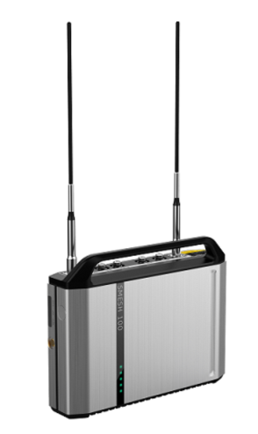

  Caltta sMesh Helps Embassy Convoy
Background:
Due to the poor coverage of the public LTE network, the vehicle in convoy could not timely and effectively transmit local audio and video to the command center. The embassy requires a method which could trasfer the real-time video and audio from the vehicle in convoy to the command center
Service:
The project is equipped with sMesh system and multimedia service system. sMesh system acts as the backhaul of the multimedia service system between the vehicle and the command center.
One sMesh equipment is installed on top of the embassy building, and others are installed inside the vehicle. The vehicles in the middle act as the next hop of the backhaul, making sure the videos from the frontline be transferred to the command center successfully.

Slide 43


